Slide 1
Bus Stops:
Progress Report
Grace Sampson

Slide 2
Data
Bus Stops (dataMontgomery)
Standardize variable names
Clean row formatting (numeric columns)
Separate RideOn and MWATA bus stops
Rideon Bus Stops (Maryland.gov)
Change column types
Notes:
then joined datasets and created new variable at_least_one_stop

Slide 3
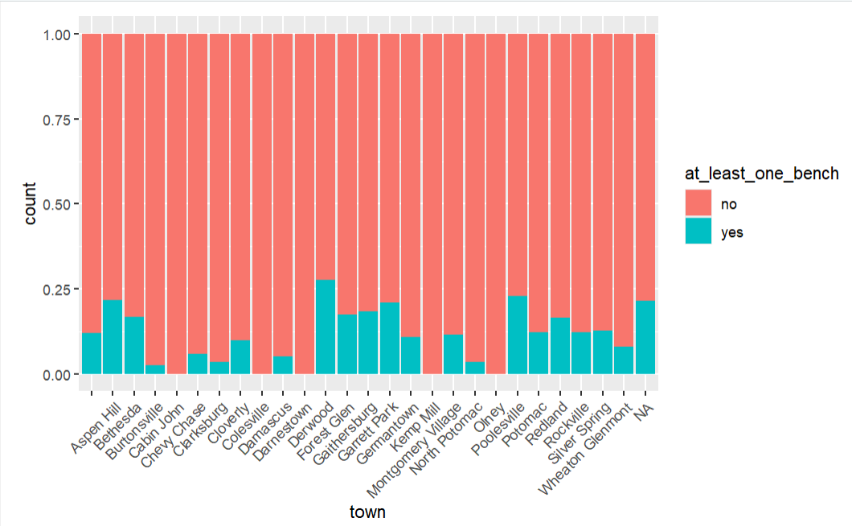
Main EDA
Derwood has highest proportion of bus stops with benches
Cabin John, Colesville, Kemp Mill and Olney have the smallest proportion
Kept NA’s

Slide 4
Next Steps
Statistical analysis
Hypothesis testing
Anova tests
Create Nearest Neighbors model
Create interactive dashboard (Tableau)
Gather additional context to make recommendations

